Slide 1


Pizza Sales Analysis

Slide 2
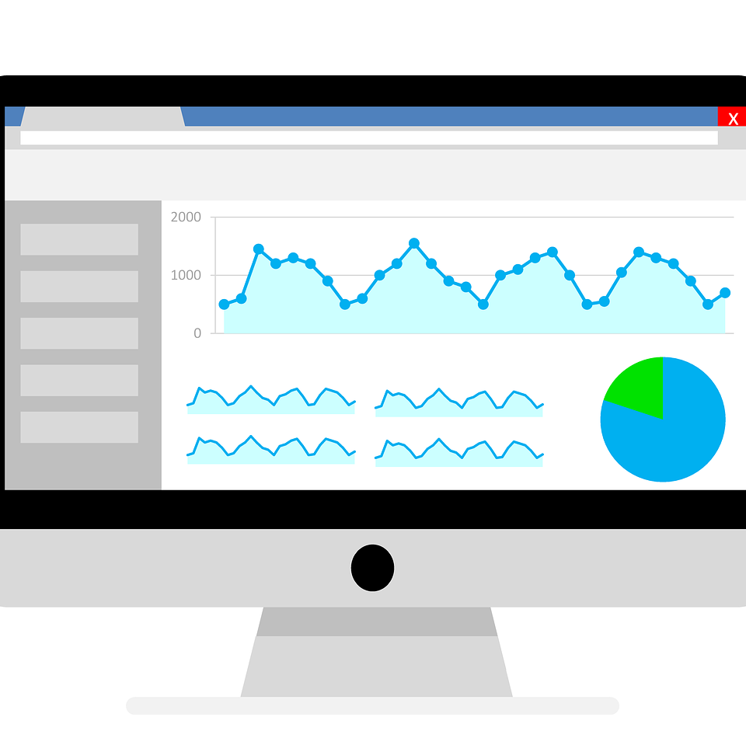
Objective
To generate actionable insights for the organization from the given Pizza Sales Data enabling informed decision making for the stakeholders such as
Top and bottom performing pizzas,
Sales performance by pizza category and size,
Hourly and weekly trend of total orders.

Slide 3

Tools/Technologies used
This project focuses on analysing the given Sales data using SQL queries and building dashboard using Tableau.
Software used:
Microsoft SQL Server Management Studio 20
Tableau 2024.1

Slide 4

Client requirement
KPIs:
Total revenue
Average order value
Total pizzas sold
Total orders
Average pizzas per order

Slide 5

Client requirement
Charts Requirement :
Hourly trend of total orders
Weekly trend of total orders
Percentage of sales by Pizza category
Percentage of sales by Pizza size
Total pizzas sold by Pizza category
Top 5 best performing pizzas by revenue, total quantity and total orders
Bottom 5 worst performing pizzas by revenue, total quantity and total orders

Slide 6



Importing Data into SQL server
Steps Involved
Connecting Data Source with Tableau
Building Dashboard
Creating the database
Running SQL queries
Documenting the results
Data cleaning and Processing
Creating different visualisations
Validating the results
Building Interactive Dashboard
Generating Report

Slide 7
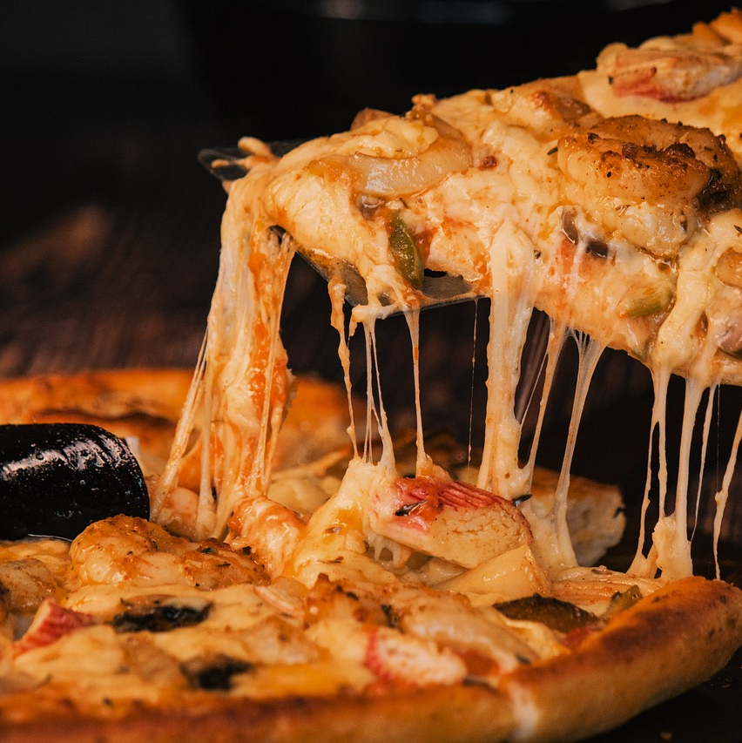
Thank You

